Slide 1
Development of GENDER CLASSIFICATION using RANDOM FOREST AND MONGODB
TEAM 6
Group members :
B.VAMSI KRISHNA - (CH.EN.U4CSE20008)
KV.PRIYANKA VARMA - (CH.EN.U4CSE20038)
P.SATHVIKA REDDY - (CH.EN.U4CSE20047)

Slide 2
Agenda
INTRODUCTION
AIM
MAIN OBJECTIVE
PROCESS FLOW OF APPROCH
PROPOSED ALGORITHM AND ARCHITECTURE
RESULT/OUTPUT
CONCLUSION
REFERENECES

Slide 3
Introduction
This is about gender classification system bases on an individual’s facial characteristics.
Previously, classification consumes lot of time and lot of resources such as human experts. which is very expensive. Because every human has their own opinion.

Slide 4
AIM
COMPLEX & DYNAMIC NATURE
EFFICIENT DATA PROCESSING
IMPROVISED ACCURACY
USE OF OPTIMAL ALGORITHM
Human testing consumes lot of time so we go for this .
Selecting efficient features and predicting for vast amount of data. Development of tools that can Detect automatically.
To decrease the manual burden and improve the classification accuracy.
Optimal algorithms like Random Forest
Which preforms well than other algorithms.

Slide 5
OBJECTIVEs
Predict the gender classification on the basis of given features.
MongoDB contains the data.
Using several Machine learning models, To predict gender classification using features.

Slide 6
PROCESS FLOW APPROACH
Collection of data from the mongoDB
Data Analyzing and Data Pre-processing
Divided into Train Dataset and Test Dataset
Feature Selection and Feature Scaling
Selection and Implementation of model
Prediction of gender classification.

Slide 7
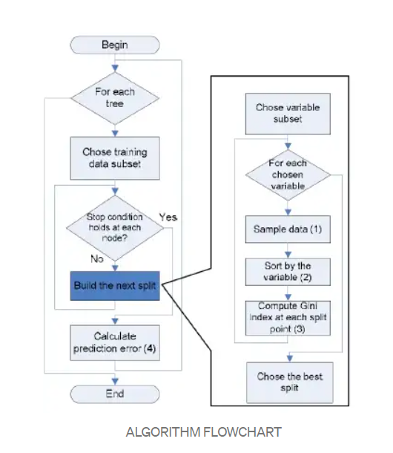
PROPOSED ALGORITHM

Slide 8
PROPOSED ARCHITECTURE
Collection of data from the mongoDB
Data Analyzing and Data Pre-processing
Train Dataset
Test Dataset
Feature Selection and Feature Scaling
Selection and Implementation of model
Gender classification

Slide 9
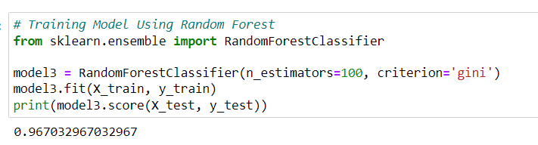
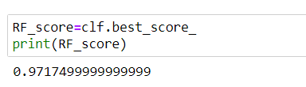
OUTPUT/RESULT

Slide 10
CONCLUSION
Implemented Gender Classification using machine learning Algorithm Random Forest Classifier. In order to increase the dataset's predictive accuracy, the Random Forest classifier uses a variety of decision trees on different subsets of the input data.
In comparison to other algorithms, it requires less training time. Even with the enormous dataset, it operates effectively and predicts the outcome with a high degree of accuracy. When a significant amount of the data is absent, accuracy can still be maintained.

Slide 11
REFERENCES
https://machinelearningmastery.com/train-test-split-for-evaluating-machine-learning-algorithms/
https://www.codewithharry.com/blogpost/mongodb/
https://www.kaggle.com/datasets/cashutosh/gender-classification-dataset
https://hevodata.com/learn/jupyter-notebook-mongodb/
https://pythontutor.com/visualize.html

Slide 12
THANK YOU

